Slide 1
Photos Related to China’s One Child Policy
Presented at the Tom Lantos Human Right Commission
November 10, 2009
By Women’s Right in China
Notes:
Change title: Photos Related to China’s One Child Policy
Presented at the Tom Lantos Human Right Commission
On November 10, 2009
By Women’s Right in China

Slide 2
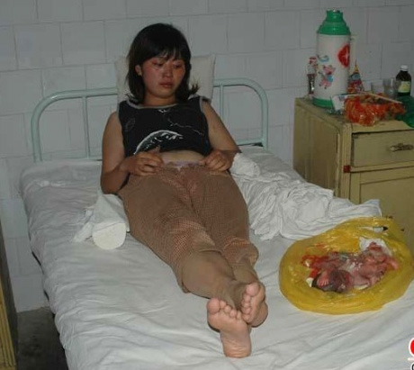
According to the One Child Policy, a married woman must get a permit before becoming pregnant, otherwise the pregnant woman will be punished with a forced abortion.
The abortion was performed in the clinic of a small town in southern China. The fetus was put in a yellow plastic bag by the side of the mother.
Notes:
Delete the word “sad.”

Slide 3
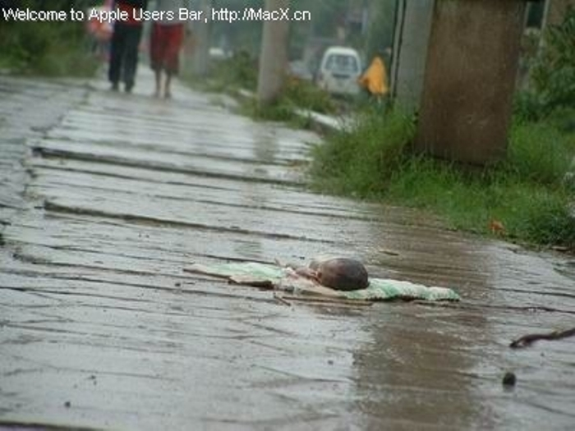
An abandoned female infant left on the sidewalk.
Because of the One Child Policy, many female babies are abandoned so their parents can have another chance to have a male.

Slide 4
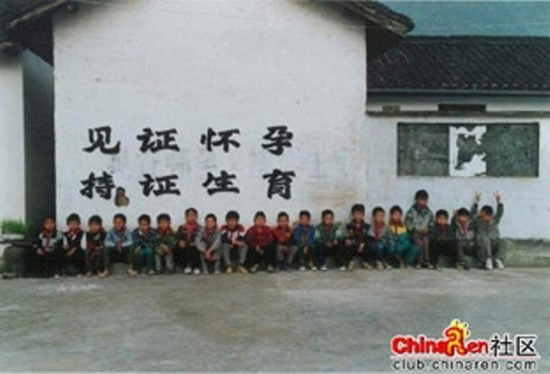
The slogan on the wall says:
“Pregnancy with permit, give birth with permit”

Slide 5
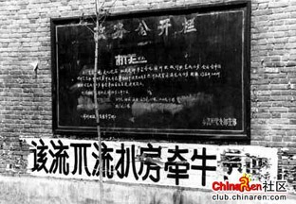
Service Announcement Board
Person/Case
The banner reads:
“When you are required by policy to get an abortion, but you don’t. Your house will be destroyed and your buffalo will be confiscated.”
Notes:
Delete blue arrows

Slide 6
“We would rather have blood flow like river, than allow one extra baby to be born.”
Notes:
“allowing” should be “allow”

Slide 7
The banner reads:
“Abort it! Kill it! Terminate it! You just can not give birth to him or her!”
Notes:
There should be an exclamation point after the word “her,” correct?

Slide 8
This is public art work, commissioned by Beijing Family Plan Department, displayed in Beijing. The art work, created by a distinguished artist, is one of the methods the authority uses to “package and beautify” its One Child Policy.

Slide 9
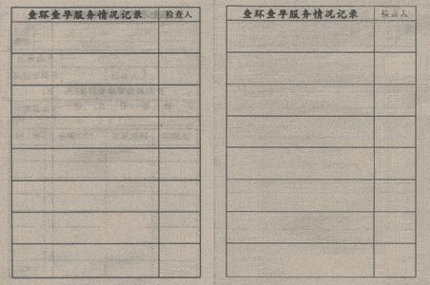
Birth control ring check record
Inspector
Pregnancy Check Service Situation Records

Slide 10
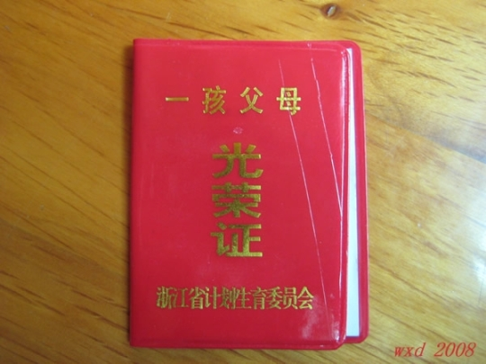
A “One Child Parent Glory” Certificate.
Zhe Jiang Providence Planned Birth Control Committee.
It is awarded to families abiding by the One Child Policy after the wife has accepted the tubal ligation.

Slide 11
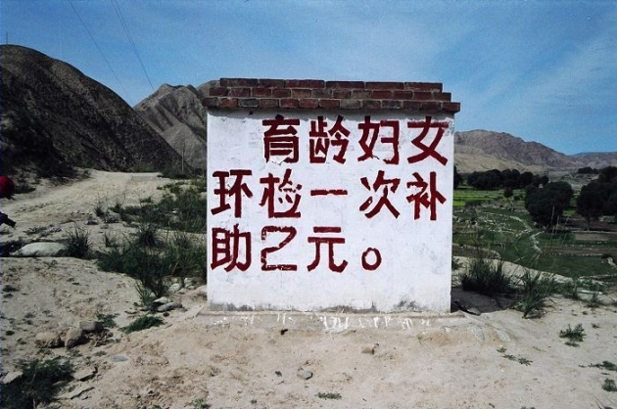
“The government provides a subsidy of RMB 2(US $0.29) for contraceptive ring check.”
This shows how China promotes One Child Policy in rural areas.

Slide 12
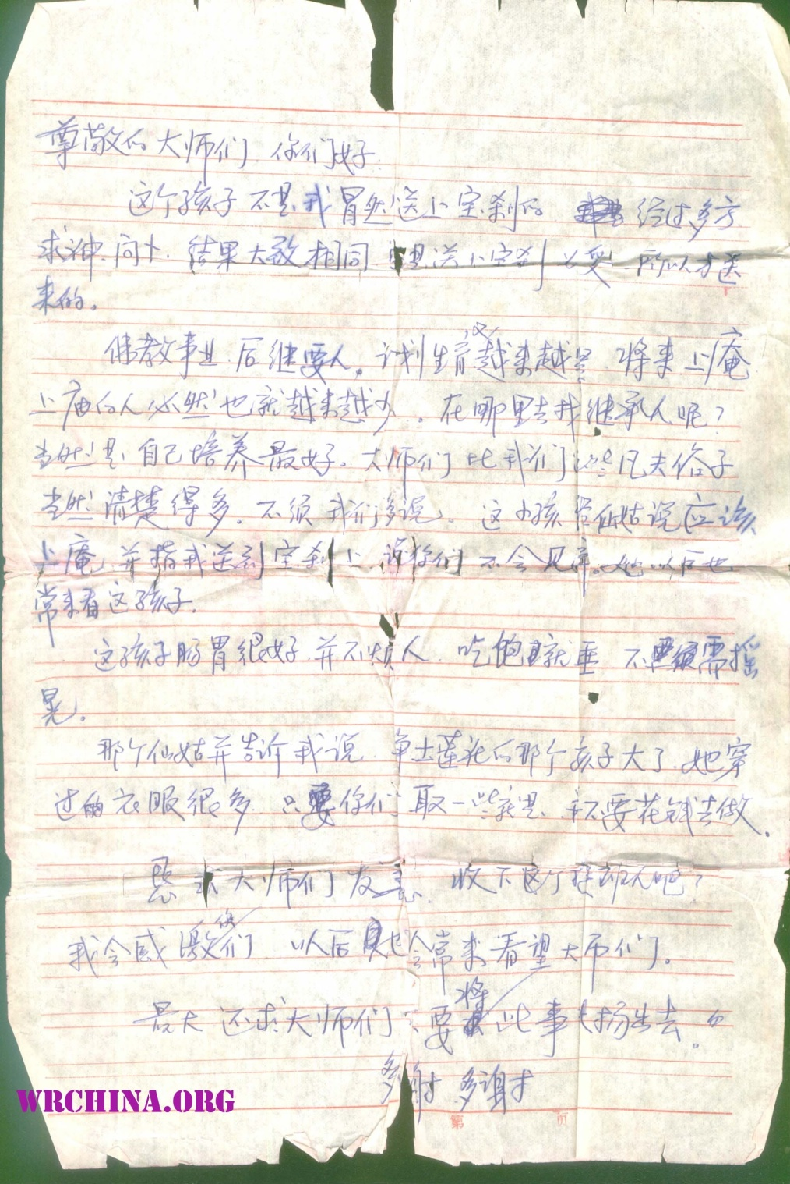
A letter left with a child who was left at the Buddhist Temple. This baby girl was abandoned at the temple so the family could have a baby boy. As a result of the One Child Policy, they could not have both.
Hello Honorable Masters,
We are not sending this child to you as a random act. We went to several temples and fortune tellers to ask for guidance, the results are very similar: bring the child to your temple, that's why we're here.
Buddhism needs successors. The planned birth control is becoming more and more intensified, therefore naturally there are less and less people coming to the temples. Where to look for successors? Of course it will be best if you can nurture your own people. You Masters would know this better than us common folks, no need to say more. This child was told by the fortuneteller to come to your temple, we were told you would not mistreat her, and we will be able to visit her often in the future.
This child has a very good appetite, not annoying. She would sleep after being fed, no need to rock her.
The same fortuneteller also told me a child in another temple has grown, she wore many clothes. You could go take some for this child, no need to spend money to make more.
Masters, I beg you to be kind, to take in this child. I’ll forever be grateful to you. I will come to visit you Masters often too.
Lastly I beg you Masters, please keep this matter quiet, do not publicize it.
Many thanks, many thanks.

Slide 13
These are females abandoned at birth at the Buddhist Temple.

